Slide 1
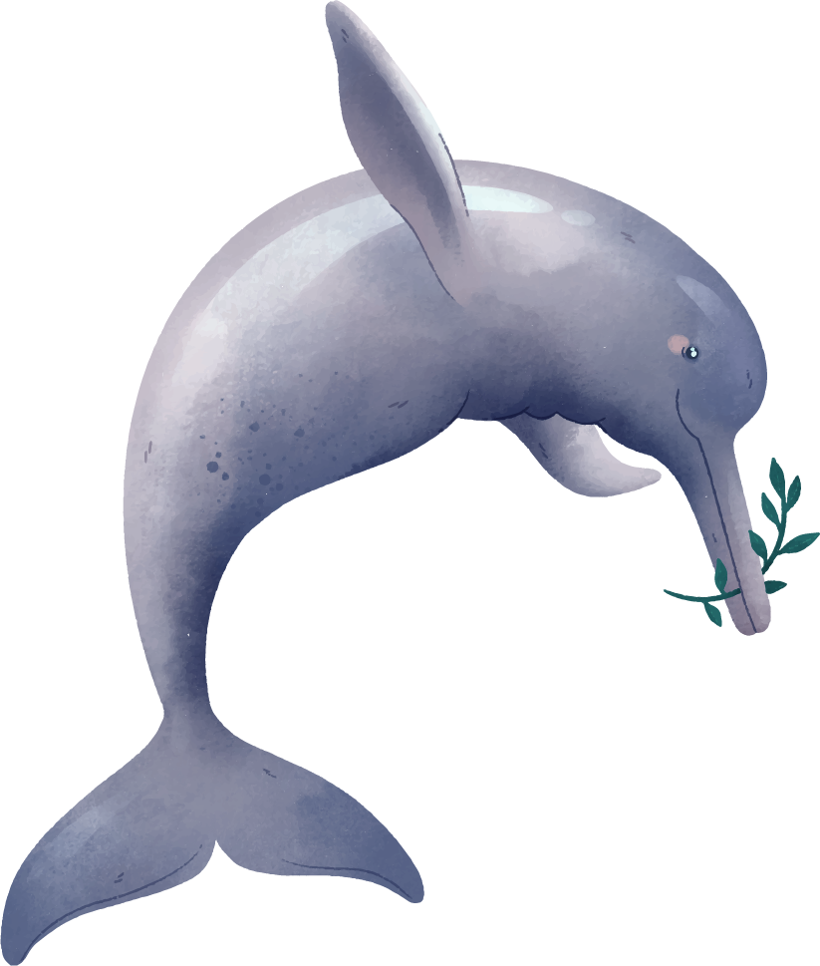
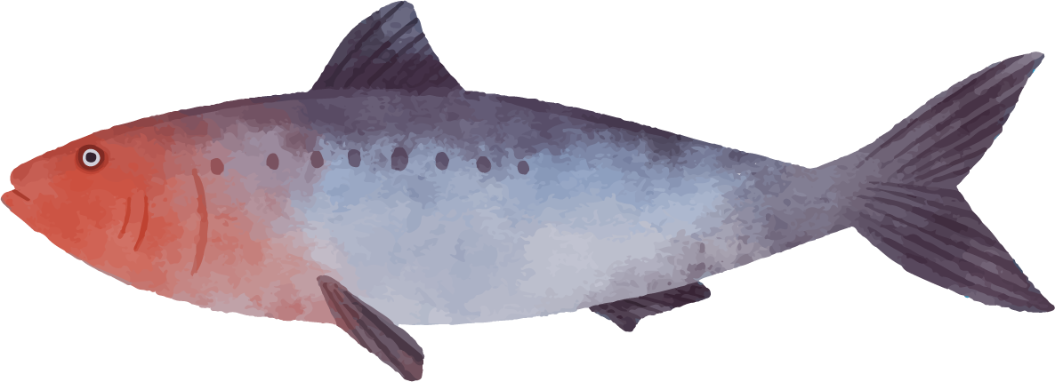
Aquarium
Scratch
Agust
2022
how to make an aquarium using scratch

Slide 2
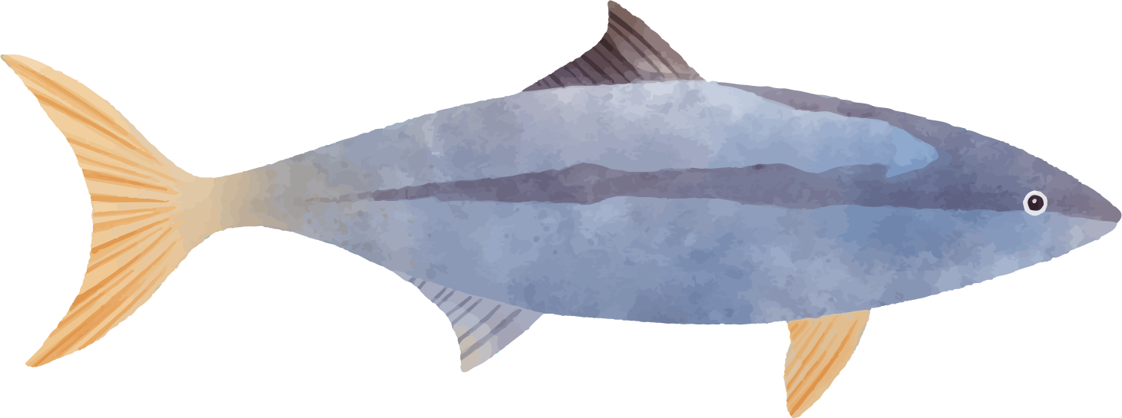
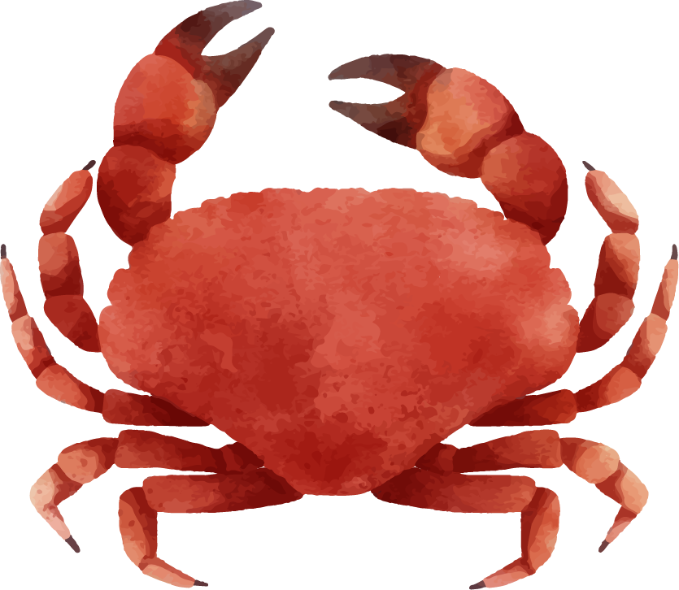
What is Scratch??
Scratch is a visual programming language for learning environment that allows beginners to learn to program without having to think about writing syntax correctly.

Slide 3
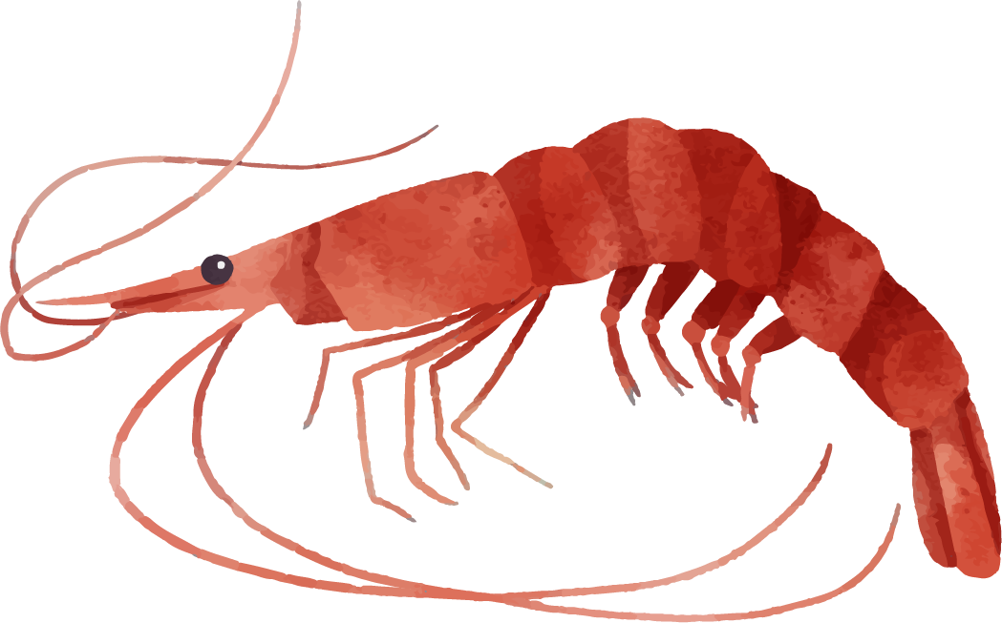
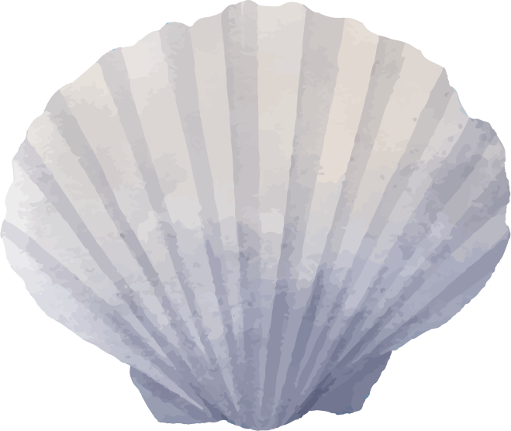

Part Of Scratch
01
03
02
04
Menu
Script Block
To open and save project, change language, see tutorials
It contains a set of command blocks used to run program
Canvas
Sprite List
The display of the program, containing the sprites
Something that becomes an object(animal,plant,human)

Slide 4
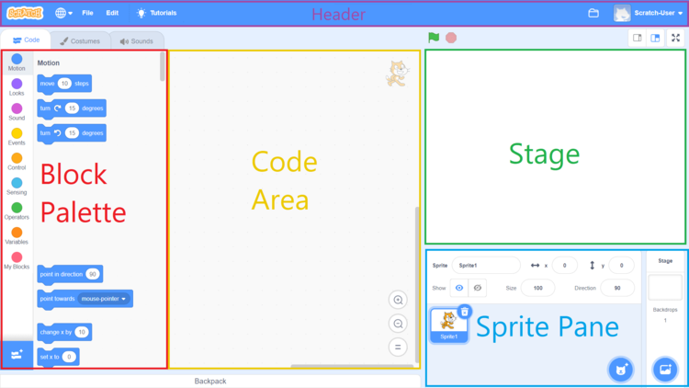

Slide 5
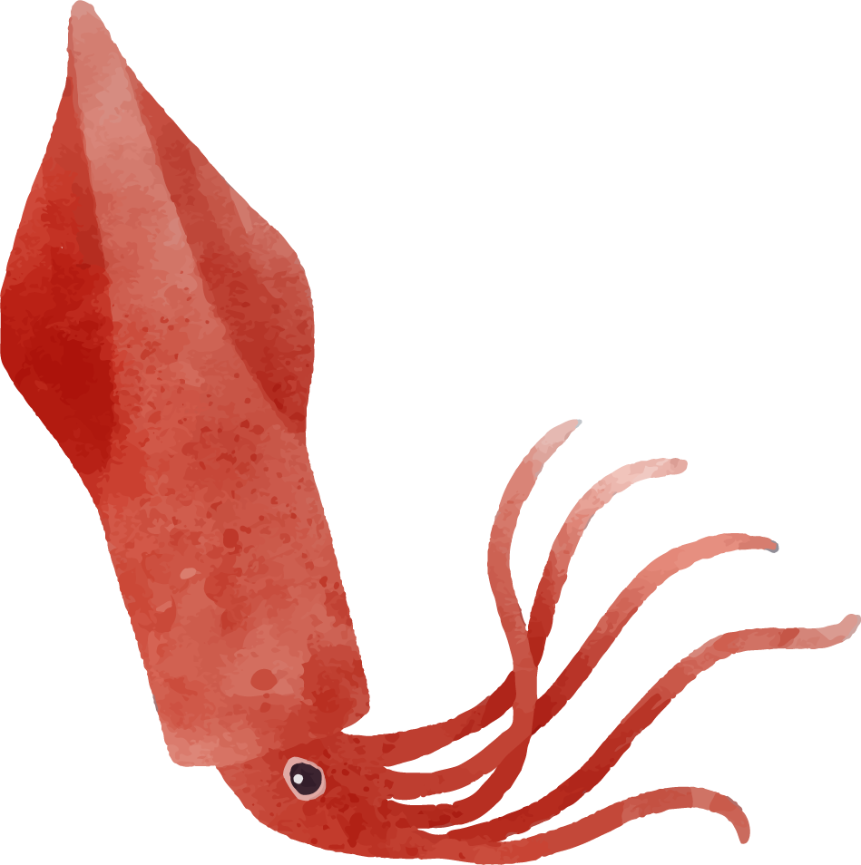
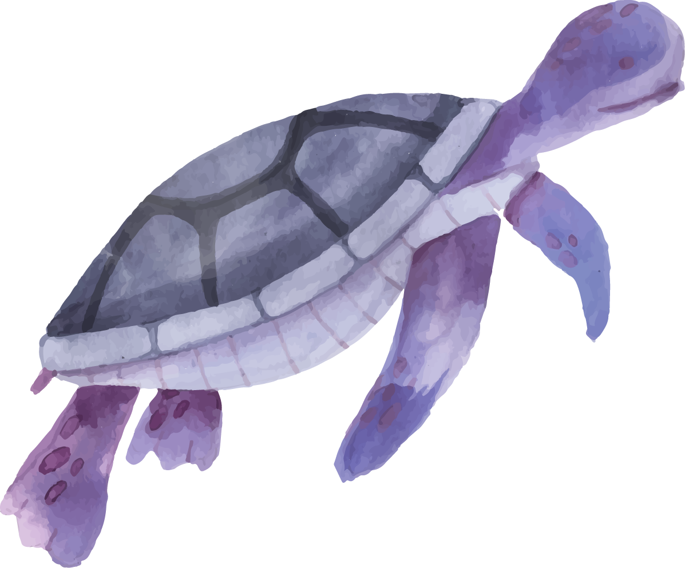
Time To Code!

Slide 6
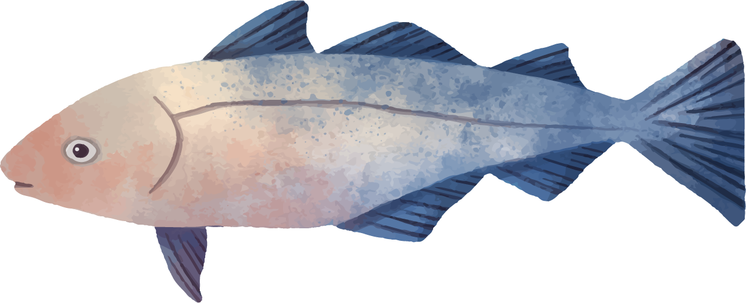
Spirate List
Fish
Crab
Octopus
etc

Slide 7
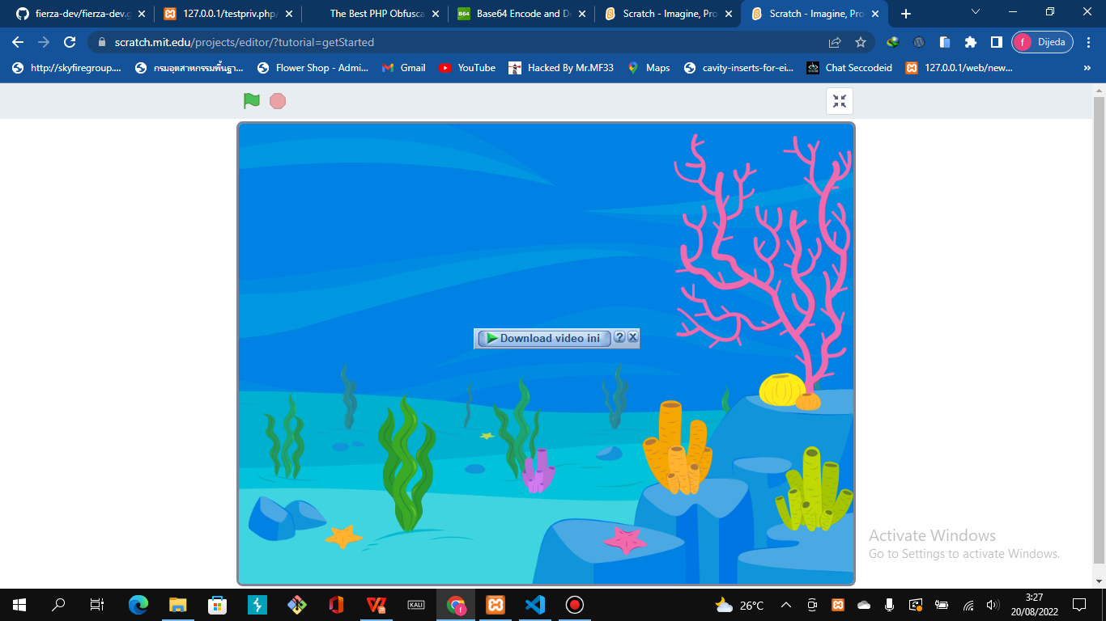
Backdrop

Slide 8
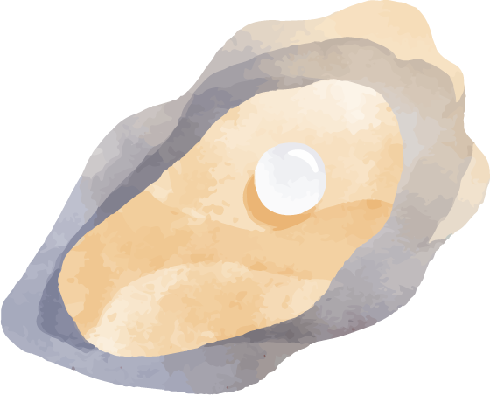
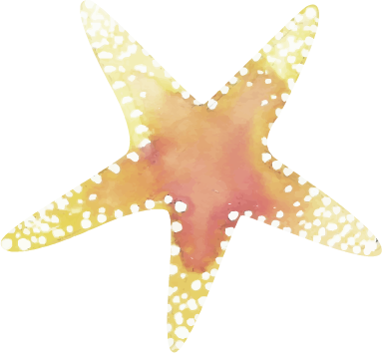
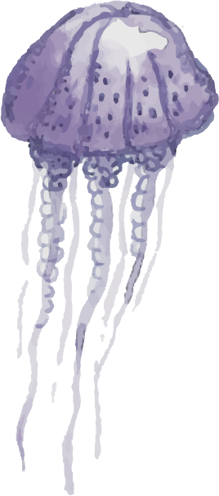
“This is a quote. Words full of wisdom that someone important said and can make the reader get inspired”
—SOMEONE FAMOUS

